Slide 1

Unit-2

Slide 2
Concept of Business Environment
1. Dynamic Interaction and Context:
- Living beings and businesses exist within dynamic environments.
- Interactions, including family, friends, and man-made structures, shape the context for both individuals and businesses.
2. Adaptation for Success:
- Business success hinges on active adaptation to the environment.
- Recognizing and responding to external factors, such as policy changes and technological advancements, is crucial for survival and prosperity.

Slide 3
Definition of business environment
1. Definition of Business Environment:
- Comprises external forces, factors, and institutions beyond the business's control.
- Influences the functioning of a business enterprise.
2. Components of Business Environment:
- Includes customers, competitors, suppliers, government, social, political, legal, and technological factors.
- Total surroundings with direct or indirect impact on business operations.

Slide 4
Definition of business environment
3. Bayard O. Wheeler's Definition:
- "The total of all things external to firms and industries affecting their organization and operation."
4. Arthur M. Weimer's Perspective:
- Encompasses the 'climate' or conditions in which economic, social, political, and institutional business operations occur.

Slide 5
Definition of business environment
5. Glueck and Jauch's View:
- External factors lead to opportunities or threats.
- Emphasizes socio-economic, technological, supplier, competitor, and government sectors as crucial.
6. Barry M. Richman and Melvgn Copen's Insight:
- Environment comprises largely external factors beyond the control of individual enterprises.
- Varies significantly from country to country, acting as the 'givers' within which businesses operate.

Slide 6
Definition of business environment
7. Business Environment as Threats and Opportunities:
- Involves both internal and external factors.
- Poses threats and provides opportunities for business exploitation.
8. Critical Nature of Understanding Business Environment:
- Business success relies on recognizing, respecting, and adapting to these factors.
- Continuous monitoring and adaptation are necessary for survival and prosperity.

Slide 7
Concept of business environment
1. Business Firm as an Open System:
Business firms operate as open systems, receiving resources from the environment and supplying goods and services in return.
2. Levels of Environmental Forces:
Environmental forces can be internal or external.
External forces may operate at national, regional, or international levels.

Slide 8
Concept of business environment
3. Opportunities and Threats:
Environmental forces provide opportunities and threats to businesses.
Organizations aim to seize opportunities and address threats through internal adjustments.
4. Reactive Nature to External Environment:
Businesses cannot alter the external environment; they react to it.
Internal components are adjusted to align with external opportunities and mitigate threats.

Slide 9
Concept of business environment
5. Importance of Environmental Analysis:
Analyzing the business environment is crucial for survival and success.
Managers play a vital role in formulating effective business strategies based on environmental insights.
6. Dynamic Nature of Business Environment:
Business environment is dynamic, continually changing.
Adaptability and flexibility are essential for businesses to thrive.

Slide 10
Features of Business Environment
1. Sum Total of External Factors:
- Business environment encompasses all external factors greatly influencing the functioning of a business firm.
2. Diverse Factors and Forces:
- Covers a range of factors such as customers, competitors, suppliers, government, and socio-cultural, political, technological, and legal conditions.

Slide 11
Features of Business Environment
3. Dynamic and Unpredictable:
- The business environment is dynamic and undergoes continuous change.
- Changes are often unpredictable, making it challenging to forecast future developments accurately.
4. Geographical Variation:
- Differs from place to place, region to region, and country to country.
- Factors influencing businesses can vary based on geographical location.

Slide 12
Features of Business Environment
5. Dependency on Society and Government:
- Business organizations rely on society for human resources, capital, technology, information, energy, and raw materials.
- Compliance with government rules, regulations, and economic policies is essential.
6. Dynamic Entity:
- A business organization is dynamic, reflecting its operation within a dynamic business environment.
- Continuous adaptation is necessary to navigate changes and uncertainties.

Slide 13
Importance of Business Environment
1. Interaction Strengthens Business:
- Close and continuous interaction with the environment strengthens the business firm.
- Enables more effective utilization of resources.
2. Multifaceted and Dynamic Impact:
- Business environment is multifaceted, complex, and dynamic.
- Significantly influences the survival and growth of the business.

Slide 14
Importance of Business Environment
3. Identification of Strengths and Weaknesses:
- Helps identify individual strengths and weaknesses in light of technological and global developments.
- Provides insights for strategic planning.
4. Opportunities and Threats Recognition:
- Interaction with the environment reveals opportunities and threats.
- Aids businesses in successfully meeting challenges.

Slide 15
Importance of Business Environment
5. Direction for Growth:
- Opens up new frontiers of growth for business firms.
- Enables the identification of areas for expansion and development.
6. Continuous Learning for Managers:
- Environmental analysis eases the task of managers in dealing with business challenges.
- Motivates managers to continuously update their knowledge, understanding, and skills.

Slide 16
Importance of Business Environment
7. Image Building:
- Understanding the environment helps improve the image of business organizations.
- Demonstrates sensitivity to the surrounding environment.
8. Competitive Strategy Formulation:
- Assists firms in analyzing competitors' strategies.
- Enables the formulation of effective strategies to meet and surpass competition.

Slide 17
Factor Affecting Business Environment
Demographic Factors
Economic Factors
Geographical and Ecological Factors
Social and cultural Environment
Political and Legal Environment
Technological Environment

Slide 18
Demographic Factor
1. Demography Definition:
- Demography is the study of human population, encompassing size, density, distribution, and vital statistics.
2. Essential for Planning and Development:
- Crucial in modern times for planning, development, and framing laws related to society and business.

Slide 19
Demographic Factor
3. Influence on Business Opportunities:
- Population density, standard of living, education levels, and occupations influence the types of businesses entrepreneurs can undertake.
4. Impact on Business Survival and Growth:
- Business units depend on the population for survival and growth, thriving particularly in densely populated regions, with transportation playing a role in reaching less populated areas.

Slide 20
Economic Factors
1. Demand Force and Competitive Force:
- Economic forces affecting businesses are categorized into Demand Force and Competitive Force.
2. Demand Force:
- Business survival and success depend on having adequate demand for products.
- Customer ability and willingness to buy are influenced by total income, taxes, and individual savings.

Slide 21
Economic Factors
3. Factors Affecting Demand:
- Increase in taxes reduces demand.
- Individual attitudes towards saving impact demand.
- Changes in commodity prices and expectations of future changes affect demand.
4. Competitive Force:
- Price cutting, advertisement, product differentiation, marketing strategies, and consumer service are competitive tools.

Slide 22
Economic Factors
5. Price Cutting:
- Should be adopted cautiously to avoid price wars and profit reduction.
6. Advertisement:
- Powerful tool for persuading consumers; effective in monopolistic competition.
7. Product Differentiation:
- Firms seek competitive strength through unique design, color, packaging, and features.
8. Marketing Strategies and Consumer Service:
- Various marketing strategies such as installment systems, credit systems, and hire-purchase target diverse market segments.
- Consumer services like free delivery, quick service, and guarantees enhance product demand

Slide 23
Geological and Ecological Factors
Geographical Environment:
1. Influence on Industries and Business:
- Geographical conditions significantly impact the type of industries and businesses in a region.
2. Similar Tastes and Preferences:
- People in a specific geographical region generally share similar tastes, preferences, and requirements.
3. Factors Influencing Living Conditions:
- Geographical situation, physical features, climate, rainfall, humidity, and vegetation influence living conditions.

Slide 24
Geological and Ecological Factors
Geographical Environment:
4. Development of Industries:
- Industries that cater to the needs of the local population thrive in a region.
5. Profound Influence on Business Location:
- Geographical conditions exert a profound influence on the strategic location of businesses.

Slide 25
Geological and Ecological Factors
Ecological Environment:
1. Definition of Ecology:
- Ecology is the study of the interaction of living organisms with each other and their non-living environment.
2. Study of Living Organisms Interaction:
- Focuses on the relationships between living beings (humans, animals, plants) and non-living elements (air, water, soil represented by atmosphere, rivers, lakes, mountains, and land).
3. Understanding Living Being Relationships:
- Provides insights into how human beings, animals, and plants interact with elements like air, water, and soil.
4. Holistic Study of Ecosystem:
- Encompasses the entirety of living and non-living components, creating a holistic understanding of ecosystems.

Slide 26
Social & Cultural Environment
Social Environment:
1. Influence on Business Organizations:
- Social and cultural attitudes of a region significantly influence business organizations.
2. Adaptation to Social and Cultural Attitudes:
- Business practices and management techniques must align with the social and cultural attitudes of the local population.
3. Reciprocal Relationship:
- Business is both a social system and part of a larger social system represented by society.
- A reciprocal relationship should exist between business and the larger society.
4. Adaptation to Social System:
- Businesses need to adapt themselves to the social environment, recognizing their role in the broader societal context.

Slide 27
Social & Cultural Environment
Cultural Environment:
1. Class Structure and Social Roles:
- The class structure of society influences social roles, organizations, and the development of social institutions.
- Dependent on occupation, education, income level, social status, mobility, attitudes towards living, work, social relationships, and business.
2. Culture Development:
- Every society develops its own culture, representing how members behave and interact.
- Culture includes values, norms, customs, ethics, goals, and accepted behavior patterns.

Slide 28
Social & Cultural Environment
Cultural Environment:
3. Behavior and Interaction Patterns:
- Culture defines how individuals behave and interact with each other within society and beyond.
4. Element of Culture:
- Culture encompasses a range of elements such as values, norms, customs, ethics, and goals.

Slide 29
Legal and political Environment
Political Environment:
1. Government Influence on Business:
- All business firms are directly affected by the government and its programs to varying degrees.
2. Classification of Political Forces:
- Political forces can be categorized into long-term forces, quick changes, cyclical changes, and regional factors.
3. Long-term Forces:
- Secular trends influenced by prevailing political conditions and adopted business policies.

Slide 30
Legal and political Environment
Political Environment:
4. Quick Changes:
- Sudden political shifts due to events like army coups, revolts, or emergencies require rapid business adaptations.
5. Cyclical Changes:
- Periodic changes, such as general elections, leading to shifts in government, plans, and priorities.
6. Regional Factors:
- Dominance of regional considerations, influencing political decisions and leading to specific legislations or policies.

Slide 31
Legal and political Environment
Legal Environment:
1. Foundation of Business Operations:
- Business can only thrive and grow within the legal system of a country.
2. Country-specific Business Laws:
- Every country has a distinct set of laws regulating and directing business operations.
3. Complex Business Law System:
- The business law is a complex system of regulations and interventions, forming the legal environment for businesses.
4. Importance of Legal Knowledge:
- Business managers need a thorough understanding of business law to make informed management decisions.

Slide 32
Technological Environment
Technology means “the systematic knowledge of the industrial arts”. ‘Technique’ denotes the method of performance. These two are increasingly used in modern literature on industrial production. The present age is the age of technology. Technology affects the business in two ways.
Its impact on the society and
Its impact on business operation.

Slide 33
Importance of business Environment concept
Business, led by people, adapts to meet consumer needs in a dynamic world. Adapting to constant change is key for survival. Businessmen must stay informed to navigate shifts successfully. Studying the business environment is crucial for managers to ensure competitiveness in the evolving market.

Slide 34
Corporate Social Responsibility
Corporate social responsibility (CSR) refers to business practices involving initiatives that benefit society. A business's CSR can encompass a wide variety of tactics, from giving away a portion of a company's proceeds to charity, to implementing "greener" business operations.

Slide 35
Corporate Social Responsibility
There are a few broad categories of social responsibility that many of today's businesses are practicing:
Environmental efforts
Philanthropy
Ethical labour practices
Volunteering

Slide 36
Corporate Social Responsibility
Environmental efforts
One primary focus of corporate social responsibility is the environment. Businesses regardless of size have a large carbon footprint. Any steps they can take to reduce those footprints are considered both good for the company and society as a whole.
Philanthropy
Businesses also practice social responsibility by donating to national and local charities. Businesses have a lot of resources that can benefit charities and local community programs.

Slide 37
Corporate Social Responsibility
Ethical labour practices
By treating employees fairly and ethically, companies can also demonstrate their corporate social responsibility. This is especially true of businesses that operate in international locations with labour laws that differ from those in the United States.
Volunteering
Attending volunteer events says a lot about a company's sincerity. By doing good deeds without expecting anything in return, companies are able to express their concern for specific issues and support for certain organizations.

Slide 38
Describing Corporate Social Responsibility
There have been many definitions of corporate social responsibility in addition to the one given above, Buchholz identified five key elements found in most, if not all, definitions:
Corporations have responsibilities that go beyond the production of goods and services at a profit.
These responsibilities involve helping to solve important social problems, especially those they have helped create.
Corporations have a broader constituency than stockholders alone.
Corporations have impacts that go beyond simple marketplace transactions.
Corporations serve a wider range of human values than can be captured by a sole focus on economic values.

Slide 39
Key components of CSR
1. Corporate Governance:
- Key issues: accountability, transparency, and legal compliance.
- Aims at realizing corporate objectives, protecting shareholder rights, and ensuring transparency for stakeholders.
2. Business Ethics:
- Involves value-based and ethical business practices.
- Integrates core values like honesty, trust, respect, and fairness into policies, practices, and decision-making.

Slide 40
Key components of CSR
3. Workplace and Labor Relations:
- Focus on human resources as critical assets.
- Good CSR practices enhance workplace health and safety, employee relations, and work-life balance.
4. Affirmative Action/Good Practices:
- Includes equal opportunity, diversity, gender policy, and prevention of harassment.
- Reflects CSR commitment, creating a positive company image.

Slide 41
Key components of CSR
5. Supply Chain:
- Expands CSR to the entire supply chain.
- Encourages positive social, environmental, and human rights practices throughout the supply chain.
6. Customers:
- Customer satisfaction beyond cost and quality.
- Consideration of social, environmental, and supply-chain aspects for enhanced loyalty.

Slide 42
Key components of CSR
7. Environment:
- Goes beyond legal requirements.
- Involves sustainable solutions, reduced environmental impact, and eco-friendly product development.
8. Community:
- Recognizes the community as a major stakeholder.
- Involvement includes direct interactions, support for community projects, and positive changes for the local population.

Slide 43
Benefits of CSR for the Organizations
Company Benefits:
1. Improved Financial Performance:
- Social responsibility positively impacts financial performance.
2. Lower Operating Costs:
- Implementation of responsible practices leads to reduced operating costs.
3. Enhanced Brand Image and Reputation:
- Socially responsible businesses enjoy an improved brand image and reputation.

Slide 44
Benefits of CSR for the Organizations
Company Benefits:
4. Increased Sales and Customer Loyalty:
- Social responsibility attracts more customers and fosters loyalty.
5. Greater Productivity and Quality:
- Responsible practices contribute to increased productivity and product quality.
6. Employee Attraction and Retention:
- Socially responsible companies find it easier to attract and retain employees.

Slide 45
Benefits of CSR for the Organizations
Benefits to the Community and General Public:
1. Charitable Contributions:
- Businesses contribute to charitable causes, benefiting the community.
2. Employee Volunteer Programs:
- Socially responsible companies engage employees in volunteer programs.
3. Corporate Involvement in Community Initiatives:
- Companies actively participate in community education, employment, and homelessness programs.
4. Product Safety and Quality:
- Ensuring product safety and quality contributes to public well-being.

Slide 46
Benefits of CSR for the Organizations
Environmental Benefits
1. Greater Material Recyclability:
- Emphasis on recyclability improves environmental impact.
2. Better Product Durability and Functionality:
- Responsible practices result in products with enhanced durability and functionality.
3. Greater Use of Renewable Resources:
- Adoption of renewable resources supports environmental sustainability.
4. Integration of Environmental Management Tools:
- Environmental management tools, like life-cycle assessment, standards, and eco-labelling, are incorporated into business plans.

Slide 47
Examples of CSR Initiatives in India
1. ITC Limited:
- Initiative: 'e-Choupal' leveraging information technology.
- Activities:
- Creating livelihoods for poor tribals on wastelands.
- Investing in rainwater harvesting for irrigation.
- Empowering rural women to become entrepreneurs.
- Providing infrastructural support to make schools engaging.
- Impact: Touches the lives of nearly 3 million villagers across India.

Slide 48
Examples of CSR Initiatives in India
2. Larsen & Toubro (L&T) Limited:
- Initiative: Construction Skills Training Institute (CSTI) promoting Construction Vocational Training.
- Activities:
- Offering free basic training in various construction trades.
- Setting up branches to extend training opportunities.
- Impact: Trains about 300 candidates annually, producing skilled workmen for L&T's projects, contributing to rural skill development and economy.

Slide 49
Examples of CSR Initiatives in India
3. India Aluminium Company Limited:
- Initiative: Women's Empowerment project in collaboration with CARE-Jharkhand.
- Activities:
- Establishment of Self Help Groups (SHG) in 30 villages.
- Promotion of Nutrition Gardens and improved agricultural practices.
- Strengthening ICDS/health services through SHGs.
- Impact: Empowers around 2000 women, improves lives, enhances child and family welfare, and addresses socio-economic challenges in Jharkhand.

Slide 50
Corporate Governance
Corporate Governance Overview:
1. Definition:
- Corporate Governance involves the direction and management of a corporation, aligning business operations with stakeholders' interests.
2. Participants:
- Involves shareholders, board of directors, and company management in shaping corporate performance.
3. Balancing Goals:
- Aims to balance individual and societal, as well as economic and social goals.

Slide 51
Corporate Governance
4. Owner-Manager Relationship:
- Emphasizes a healthy relationship between owners and managers, ensuring performance alignment with standards.
5. Finance Providers' Assurance:
- Addresses how finance providers secure a fair return on investment, distinguishing roles between owners and managers.
6. Strategic Decision Making:
- Deals with effective strategic decision-making, granting authority and responsibility to the Board of Directors.
.

Slide 52
Corporate Governance
7. Market-Oriented Economy:
- Arises from the need in today's market-oriented economy, driven by efficiency and globalization.
8. Value Addition:
- Essential for adding value to stakeholders and promoting transparency for balanced economic development.
9. Stakeholder Interests:
- Safeguards the interests of all shareholders, ensuring the exercise of their rights is recognized.
10. Broad Scope:
- Encompasses social and institutional aspects, fostering a trustworthy, moral, and ethical business environment.

Slide 53
Corporate governance in India
The Indian corporate scenario was more or less stagnant till the early 90s.
The position and goals of the Indian corporate sector has changed a lot after the liberalisation of 90s.
India’s economic reform programme made a steady progress in 1994.
India with its 20 million shareholders, is one of the largest emerging markets in terms of the market capitalization.

Slide 54
Corporate governance of India has undergone a paradigm shift
In 1996, Confederation of Indian Industry (CII), took a special
initiative on Corporate Governance.
The objective was to develop and promote a code for corporate governance to be adopted and followed by Indian companies, be these in the Private Sector, the Public Sector, Banks or Financial Institutions, all of which are corporate entities.
This initiative by CII flowed from public concerns regarding the protection of investor interest, especially the small investor, the promotion of transparency within business and industry

Slide 55
Securities and Exchange Board of India
The Government of India's securities watchdog, the Securities Board of India, announced strict corporate governance norms for publicly listed companies in India.
The Indian Economy was liberalised in 1991. In order to achieve the full potential of liberalisation and enable the Indian Stock Market to attract huge investments from foreign institutional investors (FIIs), it was necessary to introduce a series of stock market reforms.
SEBI, established in 1988 and became a fully autonomous body by the year 1992 with defined responsibilities to cover both development and regulation of the market.

Slide 56
SEBI
On April 12, 1988, the Securities and Exchange Board of India (SEBI)was established with a dual objective of protecting the rights of small investors and regulating and developing the stock markets in India.
In 1992, the ‘BSE’ ,the leading stock exchange in India, witnessed the first major scam masterminded by Harshad Mehta.
Analysts felt that if more powers had been given to SEBI,the scam would not have happened.
•As a result the ‘GoI’ brought in a separate legislation by the name of ‘SEBI Act 1992’and conferred statutory powers to it.
Since then, SEBI had introduced several stock market reforms. These reforms significantly transformed the face of Indian Stock Markets

Slide 57
SEBI and Clause 49
SEBI asked Indian firms above a certain size to implement Clause 49, a regulation that strengthens the role of independent directors serving on corporate boards.
On August 26, 2003, SEBI announced an amended Clause 49 of the listing agreement which every public company listed on an Indian stock exchange is required to sign. The amended clauses come into immediate effect for companies seeking a new listing.

Slide 58
The major changes to Clause 49…
Independent Directors —1/3 to ½depending whether the chairman of the board is a non-executive or executive position.
Non-Executive Directors ----The total term of office of non-executive directors is now limited to three terms of three years each.
Board of Directors-----The board is required to frame a code of conduct for all board members and senior management and each of them have to annually affirm compliance with the code.

Slide 59
Clause 49..
Audit Committee----Financial statements and the draft audit report of
management discussion and analysis of…
Financial condition
Result of operations of compliance with laws
Risk management letters
Letters of weaknesses in internal controls issued by statutory
Internal auditors
Removal and terms of remuneration of the chief internal auditor
Whistleblower Policy ----This policy has to be communicated to all employees and whistleblowers should be protected from unfair treatment and termination.
Subsidiary Companies-----50% non-executive directors & 1/3 &
½independent directors depending on whether the chairman is non- executive or executive.

Slide 60
Disclosures----Contingent liabilities./Basis of related party transactions.
/Risk management/ . Proceeds from initial public offering/ .
Remuneration of directors.
Certifications -> reviewed the necessary financial statements and directors’report; established and maintained internal controls, disclosed to the auditors and informed the auditors and audit committee of any significant changes in internal control
and/or of accounting policies during the year.

Slide 61
Conclusion
As Indian companies compete globally for access to capital
markets, many are finding that the ability to benchmark against world-
class organizations is essential.
For a long time, India was a managed, protected economy with the corporate sector operating in an insular fashion.
But as restrictions have eased, Indian corporations are emerging on the world stage and discovering that the old ways of doing business are no longer sufficient in such a fast-paced global environment.

Slide 62


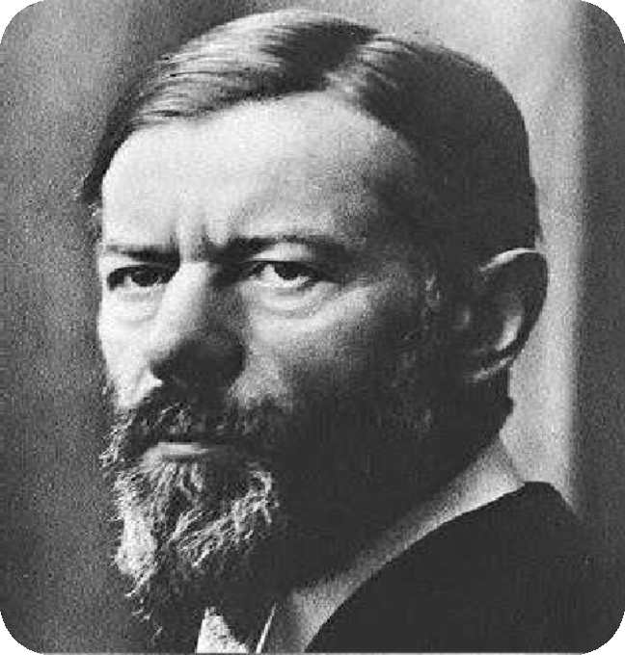

The great German sociologist and political economist
was born on 21 April 1864.
He worked in the field of economics sociology, history, law, politics and philosophy at the university of Berlin, Vienna and university of Munich.
On 14 Jun 1920 he left the world due to pneumonia.

Slide 63

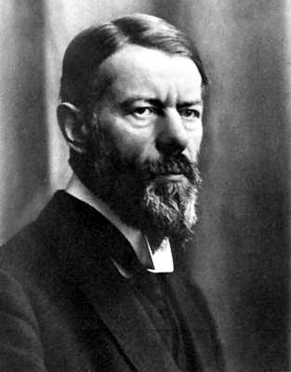
Bureaucracy / Contribution of Max Weber
Max weber’s main contribution to management is his theory of authority structure and his description of organizations based on the nature of authority
relations within them. Weber's view of bureaucracy (or bureaucratic management) was a system of power where leaders exercise control over others -- a system based on discipline.

Slide 64



Features of Bureaucracy
Administrative Class.
Bureaucratic organizations generally have administrative class responsible for maintaining coordinative activities of the
members.
Hierarchy.
Hierarchy is a system of ranking various positions in descending scale from to bottom of the hierarchy serves as lines of communication and delegation of authority.
3. Division of work
Division of labour tries ensure that each office has a clearly-defined area of competence within the each official knows the areas in which he operate and the areas in which he must abstain from action.
organization. this
organization and

Slide 65
Features of Bureaucracy
Official Rules
A rational approaches to organization calls for a system of maintaining rules to ensure twin requirements of uniformity and coordination of effort by individual members in the organization.
Impersonal Relationships.
A notable feature of bureaucracy is that relationship among individuals are governed through the system of official authority and rules.
Official Record.
The decisions and activities of the organization are formally recorded and preserved for further reference.

Slide 66












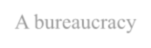







Jobs Broken down into simple, routine,& well-defined tasks
Managers are career professionals, Not owners of units they manage
Positional organized in a
hierarchy with a clear
chain of command
Division
Of Labor
Career
orientation
Authority
Hierarchy
A bureaucracy
Should have
Weber’s Bureaucracy
impersonality
Formal Selection
Formal Rules &
Regulations
Uniform application of rules & controls ,not according to personalities
People selected for jobs based on technical qualification
System of written rules & standard operating procedure

Slide 67


Advantage of Bureaucracy
It Leads to Consistent Employee Behaviour.
It Eliminates Conflicting Job Duties.
The Maximum Utilization of Humana resources.
The Workers become Specialists.
Continuance of the Organization.

Slide 68

Disadvantage/ Criticism of Bureaucratic Model
Too much of Paperwork.
Employees Think less for the organization.
No initiative and Growth of the workers
There is a Resistance to change.

Slide 69

Bureaucratic organization is criticized because of the following reasons :-
Too much emphasis on rules and regulations. The rules and regulations are rigid and inflexible.
No importance is given to informal groups. Nowadays, informal groups play an
important role in all business organisations.
Bureaucracy involves a lot of paper work. This results in lot of wastage of time, effort
and money.
There will be unnecessary delay in decision-making due to formalities and rules.

Slide 70
Bureaucratic model may be suitable for government organisations. But it is not suitable for business organisations because business organisations believe in quick decision making and flexibility in procedures.
Too much importance is given to the technical qualifications of the employees for promotion and transfers. Dedication and commitment of the employee is not considered.
There is difficulty in coordination and communication.
There is limited scope for Human Resource (HR).

Slide 71
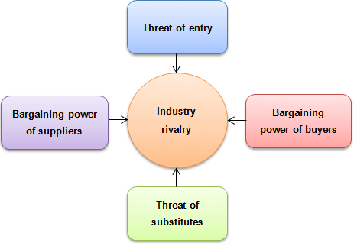
Porter’s five forces model is an analysis tool that uses five industry forces to determine the intensity of competition in an industry and its profitability level.
Understanding the tool
Five forces model was created by M. Porter in 1979 to understand how five key competitive forces are affecting an industry. The five forces identified are:
These forces determine an industry structure and the level of competition in that industry. The stronger competitive forces in the industry are the less profitable it is. An industry with low barriers to enter, having few buyers and suppliers but many substitute products and competitors

Slide 72
It is every strategist’s job to evaluate company’s competitive position in the industry and to identify what strengths or weakness can be exploited to strengthen that position. The tool is very useful in formulating firm’s strategy as it reveals how powerful each of the five key forces is in a particular industry.
Threat of new entrants. This force determines how easy (or not) it is to enter a particular industry. If an industry is profitable and there are few barriers to enter, rivalry soon intensifies. When more organizations compete for the same market share, profits start to fall. It is essential for existing organizations to create high barriers to enter to deter new entrants. Threat of new entrants is high when:
Low amount of capital is required to enter a market; Existing companies can do little to retaliate;
Existing firms do not possess patents, trademarks or do not have established brand reputation;
There is no government regulation;
Customer switching costs are low (it doesn’t cost a lot of money for a firm to switch to other industries);
There is low customer loyalty; Products are nearly identical;
Economies of scale can be easily achieved.

Slide 73
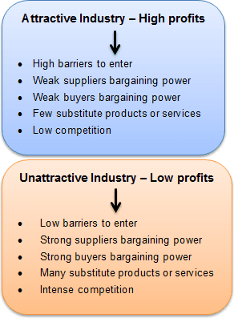

Slide 74
Bargaining power of suppliers. Strong bargaining power allows suppliers to sell higher priced or low quality raw materials to their buyers. This directly affects the buying firms’ profits because it has to pay more for materials. Suppliers have strong bargaining power when:
There are few suppliers but many buyers;
Suppliers are large and threaten to forward integrate; Few substitute raw materials exist;
Suppliers hold scarce resources;
Cost of switching raw materials is especially high.
Bargaining power of buyers. Buyers have the power to demand lower price or higher product quality from industry producers when their bargaining power is strong. Lower price means lower revenues for the producer, while higher quality products usually raise production costs. Both scenarios result in lower profits for producers. Buyers exert strong bargaining power when:
Buying in large quantities or control many access points to the final customer; Only few buyers exist;
Switching costs to other supplier are low; They threaten to backward integrate; There are many substitutes;
Buyers are price sensitive.

Slide 75
Threat of substitutes. This force is especially threatening when buyers can easily find substitute products with attractive prices or better quality and when buyers can switch from one product or service to another with little cost. For example, to switch from coffee to tea doesn’t cost anything, unlike switching from car to bicycle.
Rivalry among existing competitors. This force is the major determinant on how competitive and profitable an industry is. In competitive industry, firms have to compete aggressively for a market share, which results in low profits. Rivalry among competitors is intense when:
There are many competitors; Exit barriers are high;
Industry of growth is slow or negative;
Products are not differentiated and can be easily substituted; Competitors are of equal size;
Low customer loyalty.
Although, Porter originally introduced five forces affecting an industry, scholars have suggested including the sixth force: complements.

Slide 76
Using the tool
We now understand that Porter’s five forces framework is used to analyze industry’s competitive forces and to shape organization’s strategy according to the results of the analysis. But how to use this tool? We have identified the following steps:
Step 1. Gather the information on each of the five forces
Step 2. Analyze the results and display them on a diagram
Step 3. Formulate strategies based on the conclusions

Slide 77
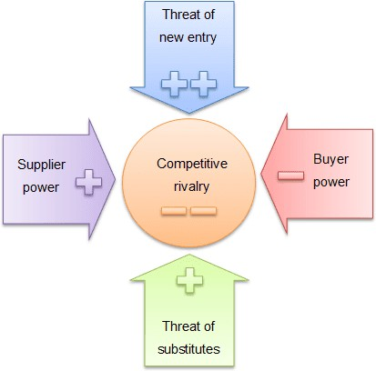
Example
This is Porter’s five forces analysis example for an automotive industry.
Porter's Five Forces Evaluation
Threat of new entry (very weak)
Large amount of capital required
High retaliation possible from existing companies, if new entrants would bring innovative products and ideas to the industry
Few legal barriers protect existing companies from new entrants
All automotive companies have established brand image and reputation Products are mainly differentiated by design and engineering quality

Slide 78
Supplier power (weak)
Large number of suppliers
Some suppliers are large but the most of them are pretty small
Companies use another type of material (use one metal instead of another) but only to some extent (plastic instead of metal)
Materials widely accessible
Suppliers do not pose any threat of forward integration
Buyer power (strong)
There are many buyers
Most of the buyers are individuals that buy one car, but corporates or governments usually buy large fleets and can bargain for lower prices
It doesn’t cost much for buyers to switch to another brand of vehicle or to start using other type of transportation
Buyers can easily choose alternative car brand
Buyers are price sensitive and their decision is often based on how much does a vehicle cost
Buyers do not threaten backward integration

Slide 79
Threat of substitutes (weak)
There are many alternative types of transportation, such as bicycles, motorcycles, trains, buses or planes
Substitutes can rarely offer the same convenience
Alternative types of transportation almost always cost less and sometimes are more environment friendly
Competitive rivalry (very strong)
Moderate number of competitors
If a firm would decide to leave an industry it would incur huge losses, so most of the time it either bankrupts or stays in automotive industry for the lifetime
Industry is very large but matured
ompeting firm’s vary but they usually compete for different consumer segments

Slide 80
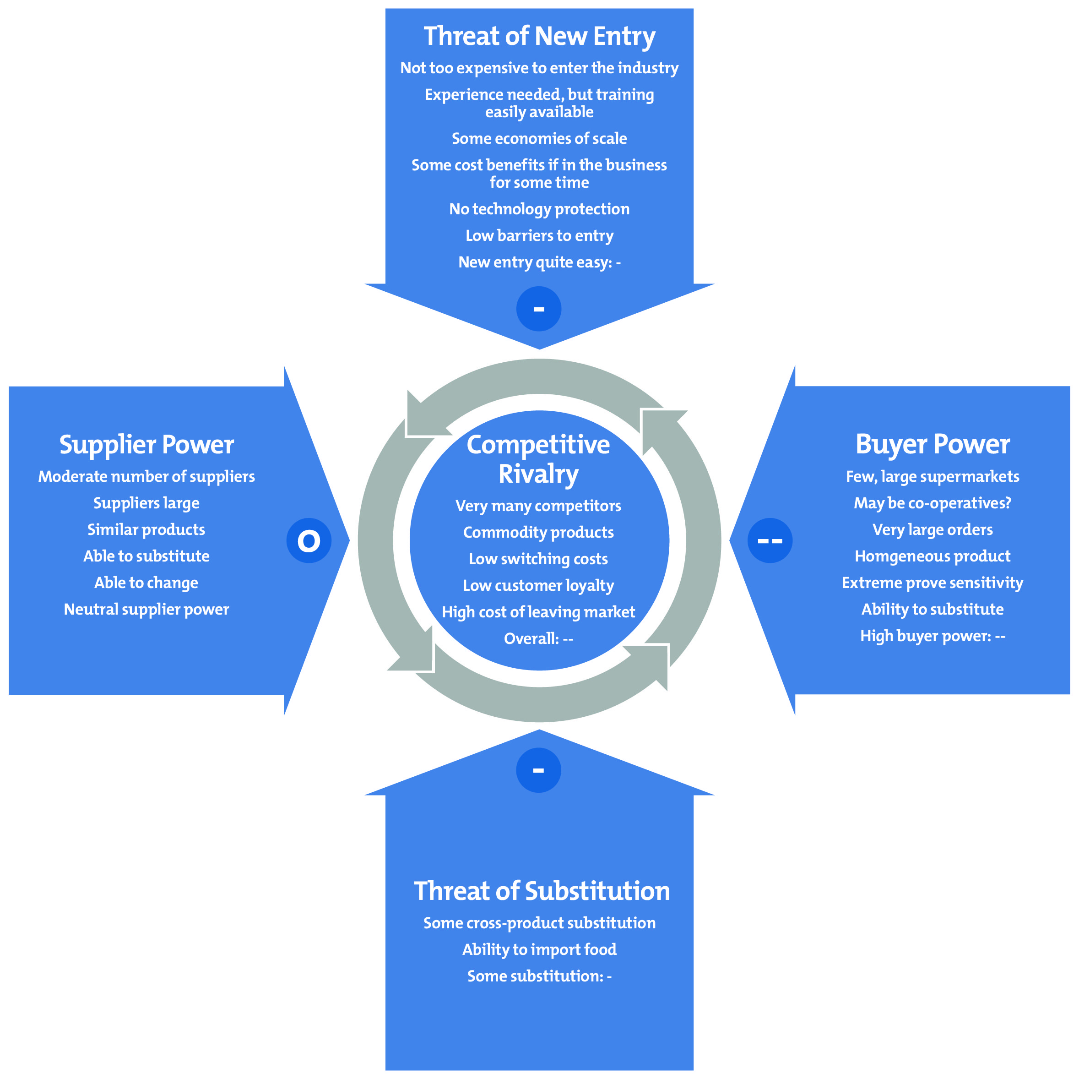
Porters Five Forces Farm Example

Slide 81
The purpose of Five-Forces Analysis
The five forces are environmental forces that impact on a company’s ability to compete in a given market.
The purpose of five-forces analysis is to diagnose the principal competitive pressures in a market and assess how strong and important each one is.

Slide 82



Threat of New Entrants
Economies of Scale
Barriers to Entry
Product Differentiation
Capital Requirements Switching Costs
Access to Distribution Channels
Cost Disadvantages Independent of Scale
Government Policy
Expected Retaliation

Slide 83
Porter’s Five Forces Model of Competition
Threat of
T_{N}hr_{e}e_{w}at of
Ent^{N}ra^{e}n^{w}ts
Entrants
Bargaining Power of Suppliers

Slide 84
Bargaining Power of Suppliers
Suppliers are likely to be powerful if:
Supplier industry is dominated by a few firms
Suppliers’ products have few substitutes
Buyer is not an important customer to supplier
Suppliers’ product is an important input to buyers’ product
Suppliers’ products are differentiated
Suppliers’ products have high switching costs
Supplier poses credible threat of forward integration
Suppliers exert power in the industry by:
* Threatening to raise prices or to reduce quality
Powerful suppliers can squeeze industry profitability if firms are unable to recover cost increases

Slide 85
Porter’s Five Forces Model of Competition
Threat of
T_{N}hr_{e}e_{w}at of
Ent^{N}ra^{e}n^{w}ts
Entrants
Bargaining Power of Suppliers
Bargaining Power of Buyers

Slide 86



Bargaining Power of Buyers
Buyer groups are likely to be powerful if:
Buyers are concentrated or purchases are large relative to seller’s sales
Purchase accounts for a significant fraction of supplier’s sales
Products are undifferentiated Buyers face few switching costs Buyers’ industry earns low profits
Buyer presents a credible threat of backward integration
Product unimportant to quality Buyer has full information
Buyers compete with the supplying
industry by:
* Bargaining down prices
* Forcing higher quality
* Playing firms off of
each other
Ch2

Slide 87
Porter’s Five Forces Model of Competition
Threat of
T_{N}hr_{e}e_{w}at of
Ent^{N}ra^{e}n^{w}ts
Entrants
Bargaining Power of Suppliers
Bargaining Power of Buyers
Threat of Substitute Products

Slide 88
Threat of Substitute Products
Keys to evaluate substitute products:
Products with similar function limit the prices firms can charge
Products with improving price/performance tradeoffs relative to present industry products
Example:
Electronic security systems in place of security guards
Fax machines in place of overnight mail delivery

Slide 89
Porter’s Five Forces Model of Competition
Threat of
T_{N}hr_{e}e_{w}at of
Ent^{N}ra^{e}n^{w}ts
Entrants
Bargaining Power of Suppliers
Rivalry Among Competing Firms in Industry
Bargaining Power of Buyers
Threat of Substitute Products

Slide 90
Rivalry Among Existing Competitors
Intense rivalry often plays out in the following ways:
Jockeying for strategic position Using price competition Staging advertising battles
Increasing consumer warranties or service Making new product introductions
Occurs when a firm is pressured or sees an opportunity
Price competition often leaves the entire industry worse off
Advertising battles may increase total industry demand, but may be costly to smaller competitors

Slide 91



Rivalry Among Existing Competitors
Cutthroat competition is more likely to occur when:
Numerous or equally balanced competitors Slow growth industry
High fixed costs High storage costs
Lack of differentiation or switching costs Capacity added in large increments Diverse competitors
High strategic stakes High exit barriers

Slide 92
COCA-COLA
Suppliers:
Price and availability of ingredients on world market
Quality speed safety, traceability, flexibility of supply chain
Buyers/consumers:
High as a result of intense competition both among branded and unbranded products.
Combined purchase power of shops, bars,
Ch2-

Slide 93
COMPETITIVE ADVANTAGE
•
The Competitive Advantage model of Porter learns that competitive strategy is about taking offensive or defensive action to create a defendable position in an industry, in order to cope successfully with competitive forces.
•
Companies can combat the pressure of the five forces and create competitive advantages.
•
There are 2 basics types of Competitive Advantage :
Cost leadership (low cost)
Differentiation

Slide 94
STRENGTHS OF FIVE FORCES MODEL:
The model is strong tool for competitive analysis at industry level.
It provides useful input for performing a SWOT analysis.

Slide 95
LIMITATIONS
•
Inside-out strategy is ignored (core competence)
•
It does not cope with synergies and interdependencies
within the portfolio of large corporations (parenting advantage)
•
The environments which are characterized by rapid, systemic and radical change require more flexible, dynamic or emergent approaches to strategy formulation (disruptive innovation)
•
Sometimes it may be possible to create completely new markets instead of selecting from existing ones (blue ocean strategy)

